Slide 1
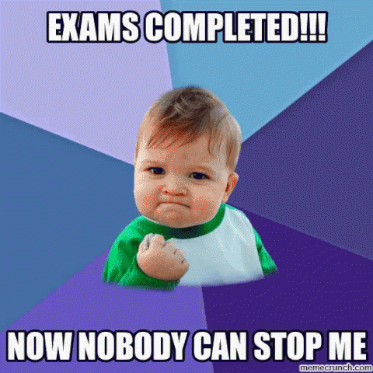
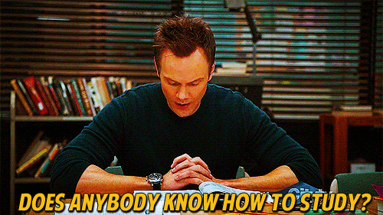
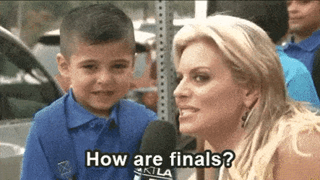

Slide 2
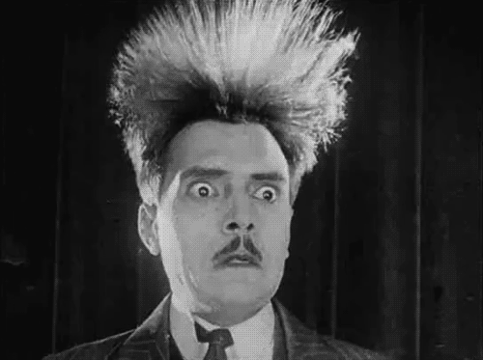
hair style

Slide 3
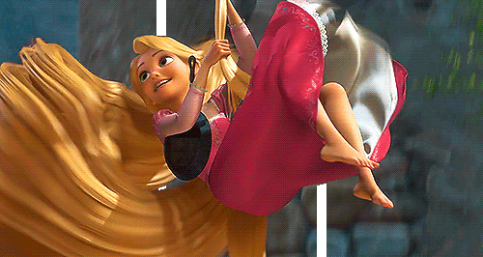
long hair

Slide 4
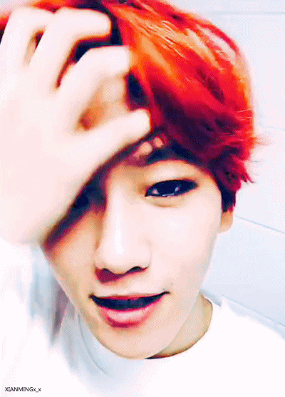
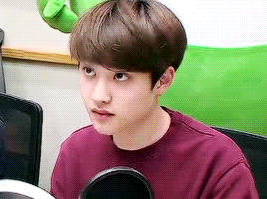
short hair

Slide 5
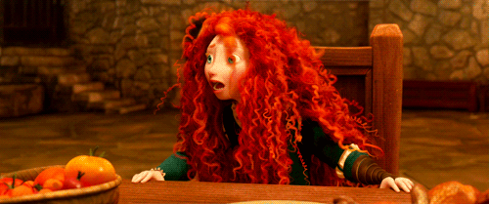
curly hair

Slide 6
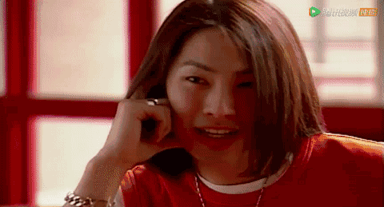
straight hair

Slide 7
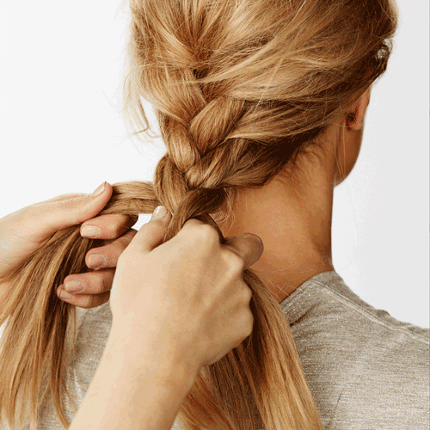
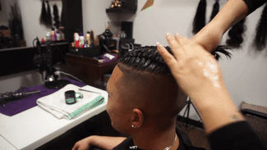
a braid

Slide 8
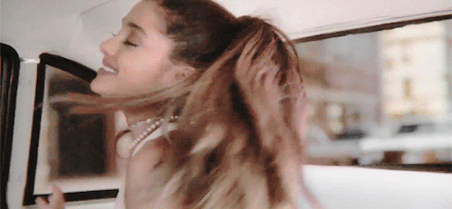
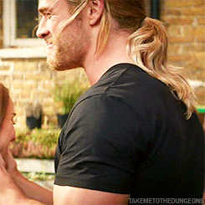
a ponytail

Slide 9
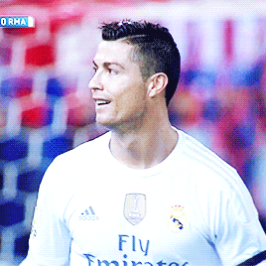
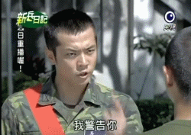
a crew cut

Slide 10
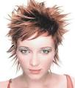
spiky hair

Slide 11
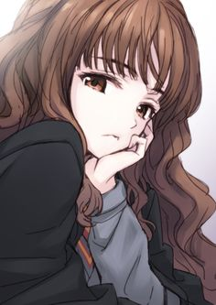
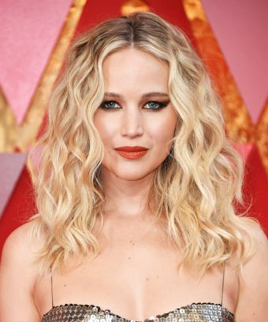
wavy hair

Slide 12
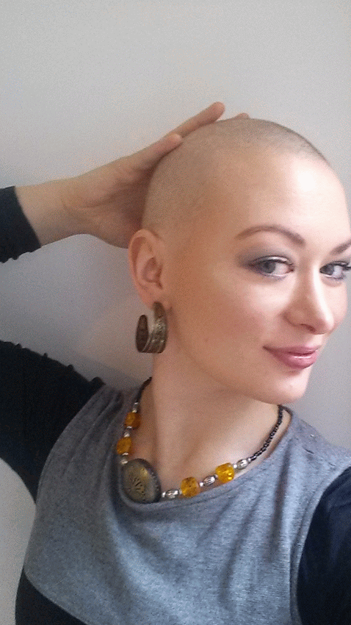
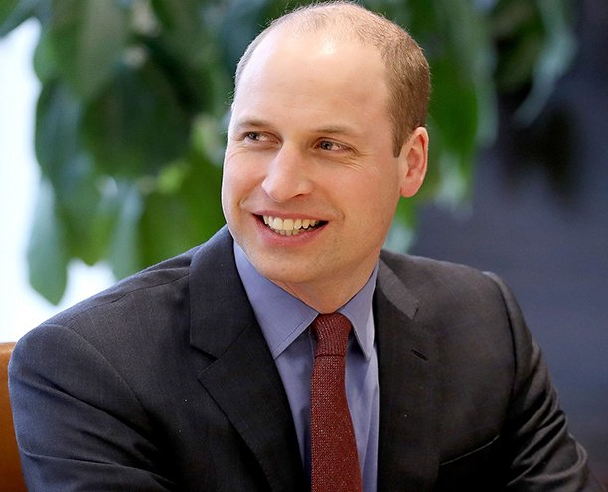
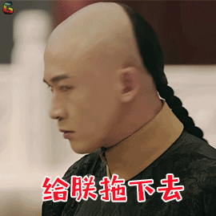
a bald head

Slide 14
Public Places

Slide 15
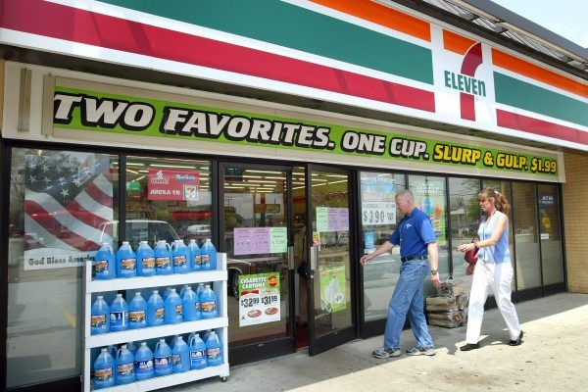
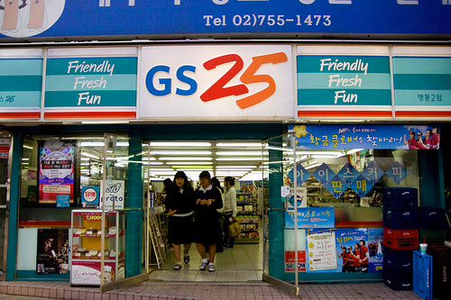
post office
convenience store

Slide 16
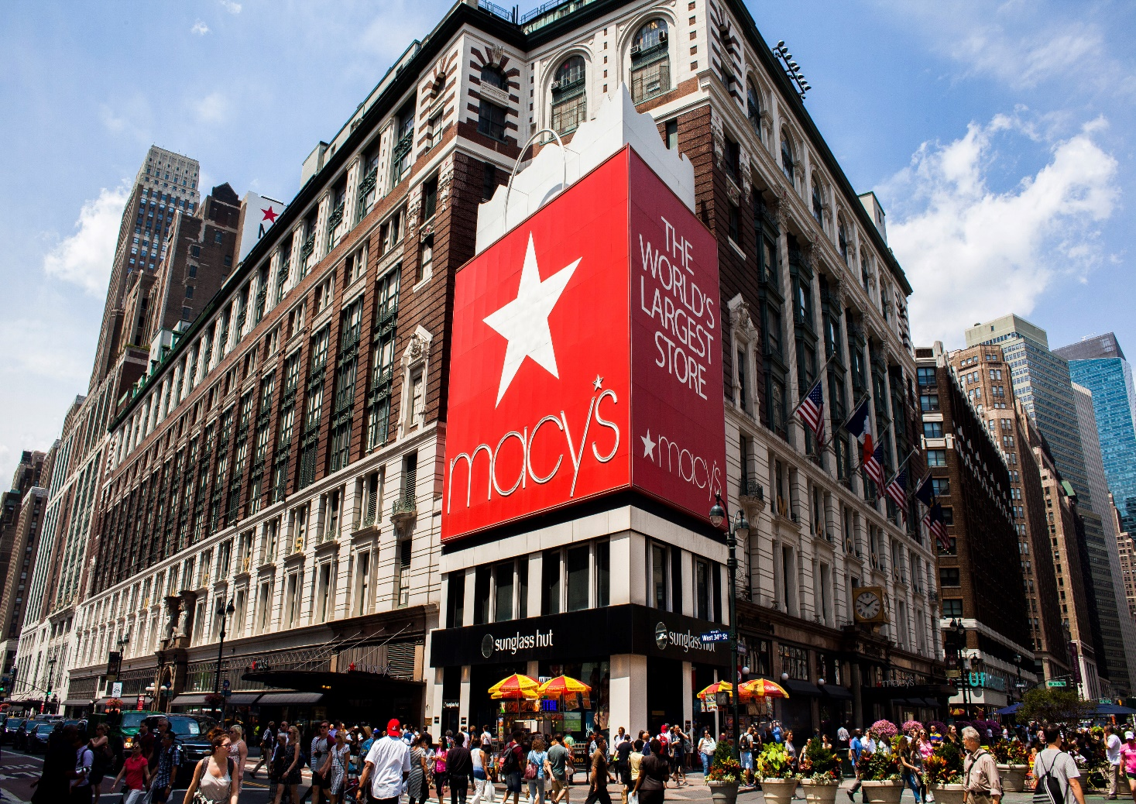
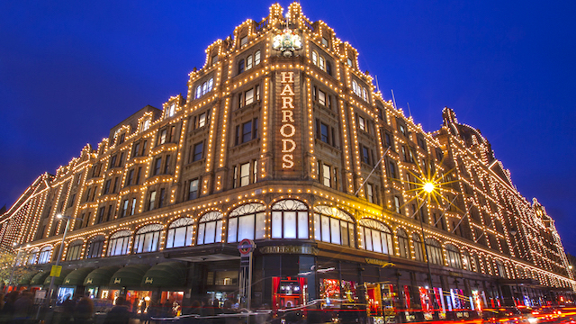
post office
department store

Slide 17
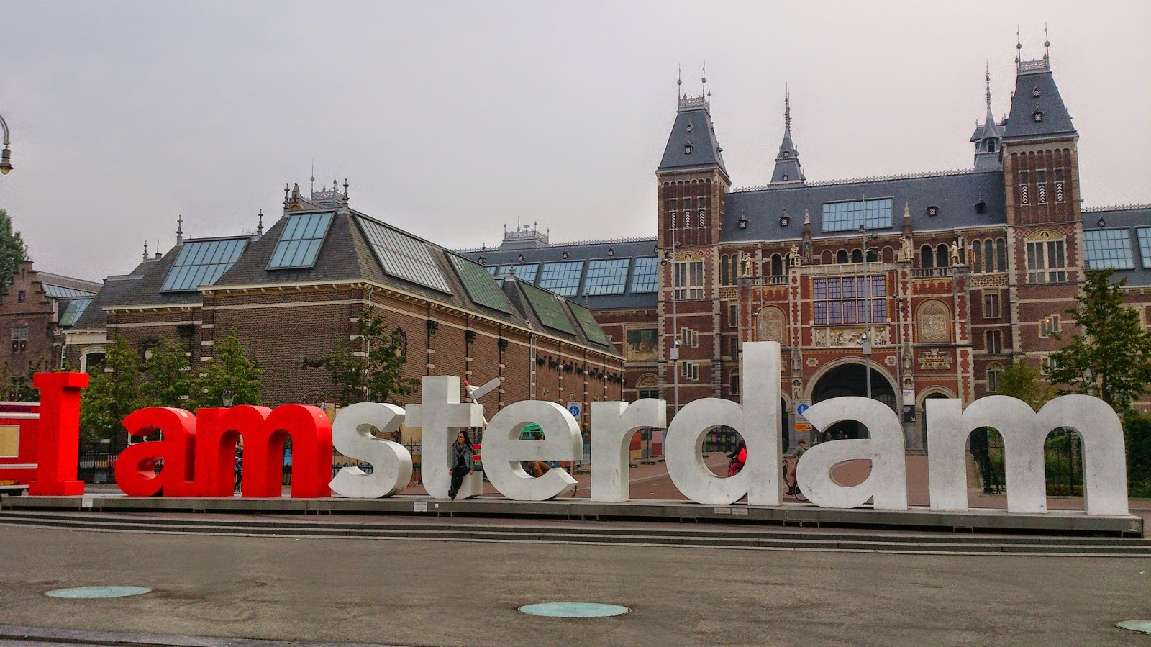
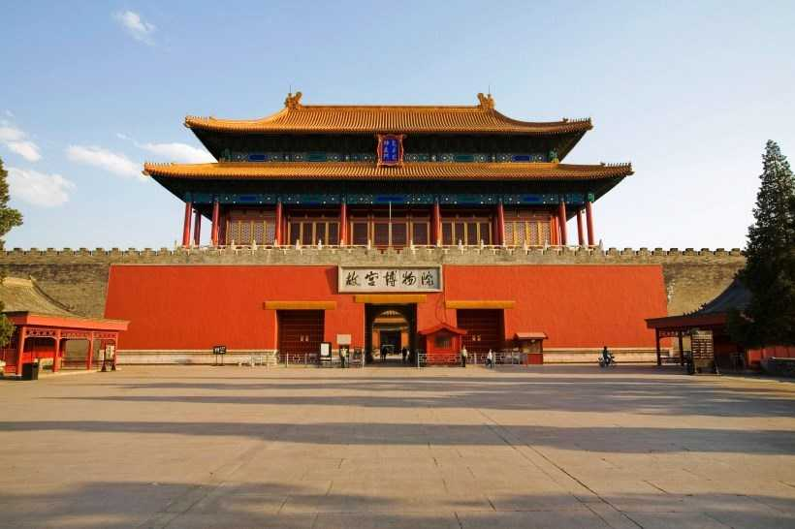
museum

Slide 18
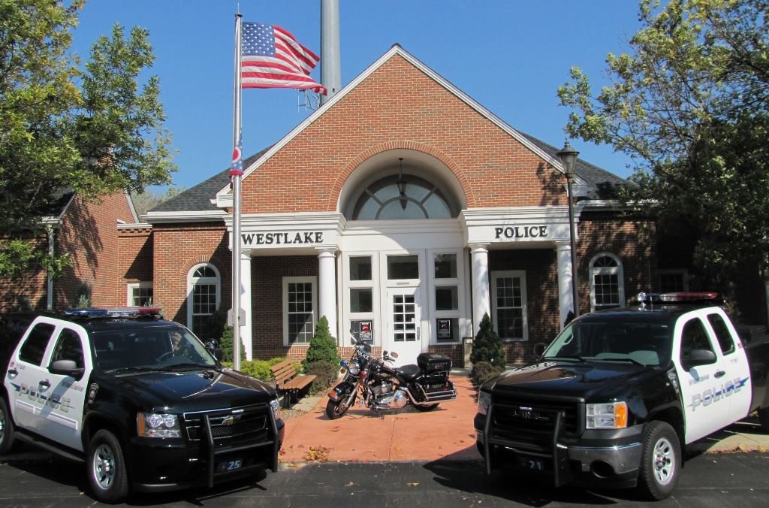
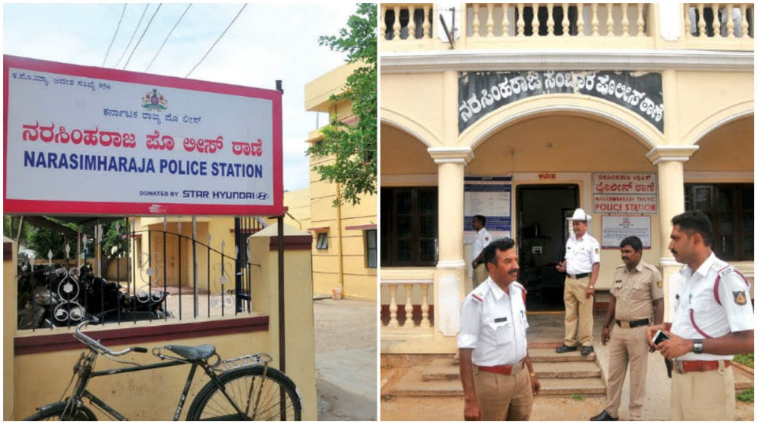
post office
police station

Slide 19
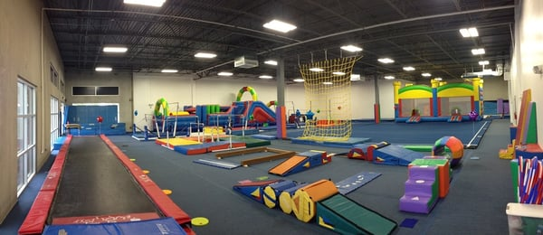
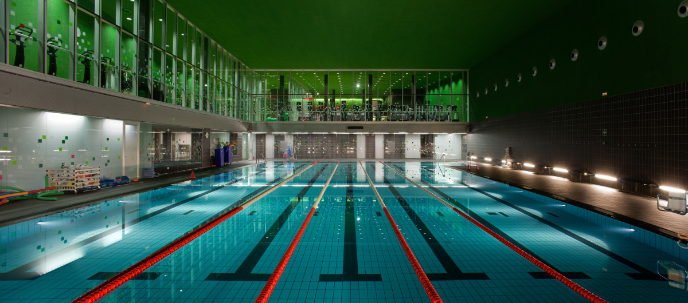
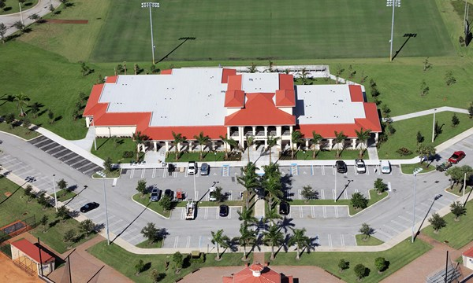
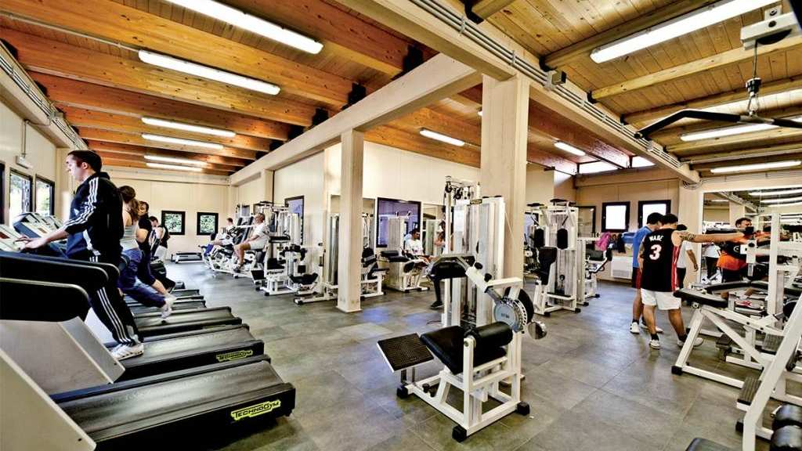
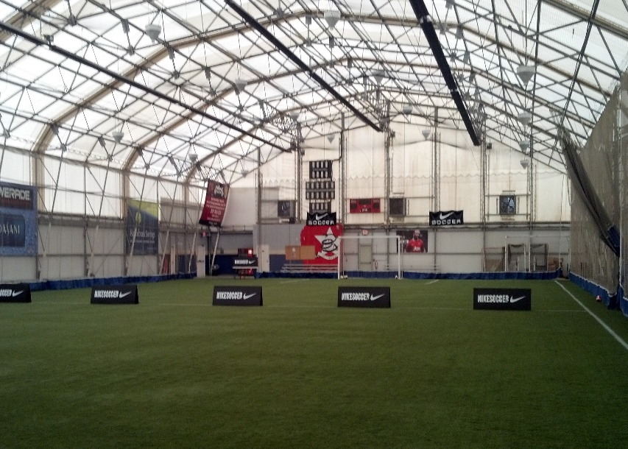
post office
sports center

Slide 20
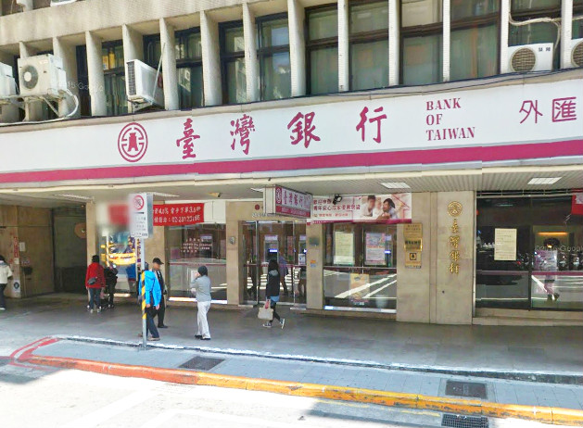
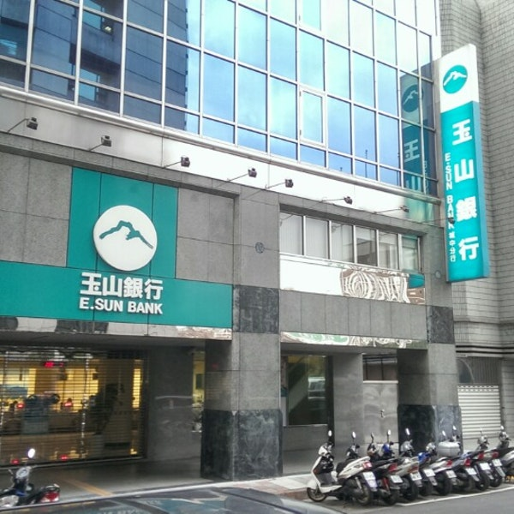
res∙tau∙rant
bank

Slide 21
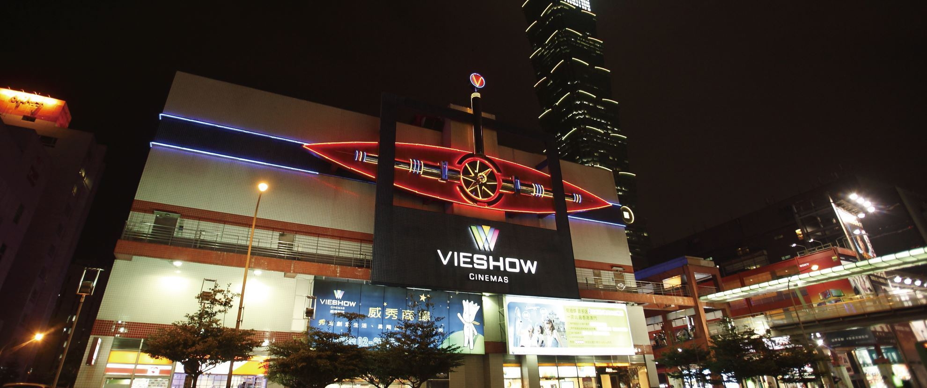
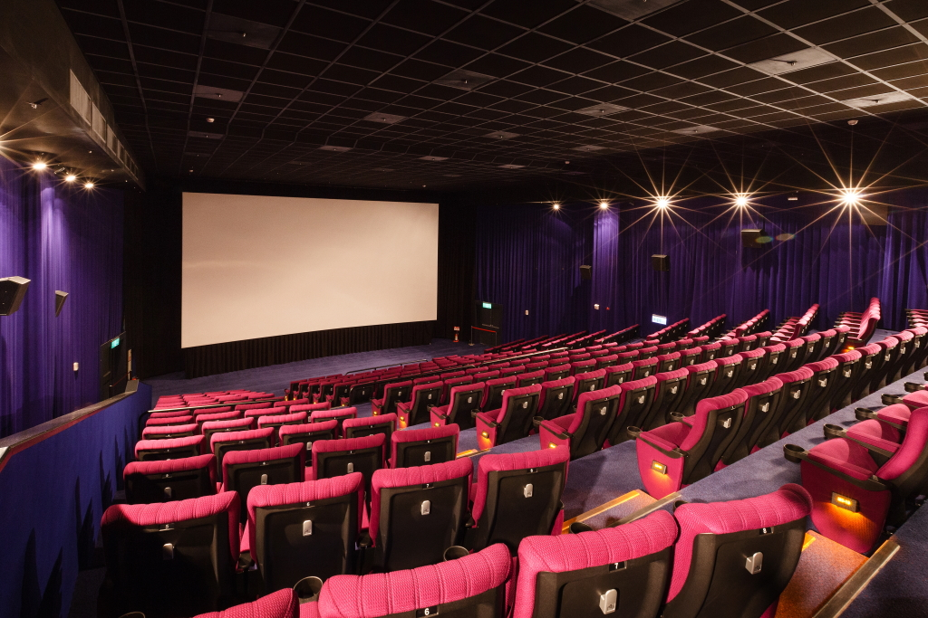
res∙tau∙rant
movie theater

Slide 22
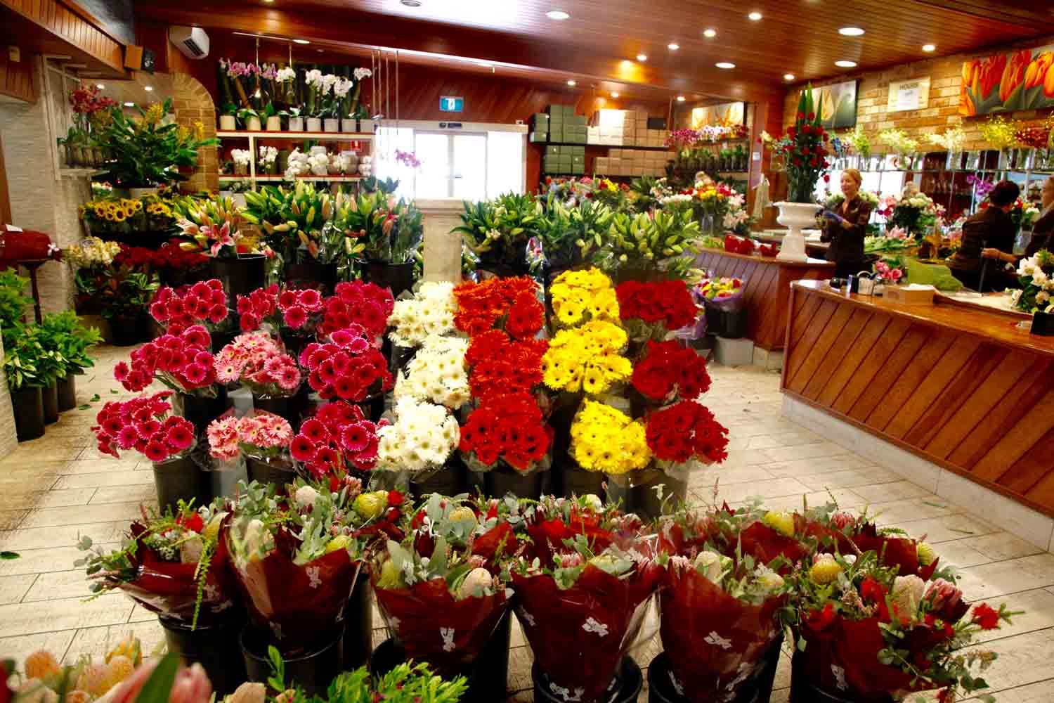
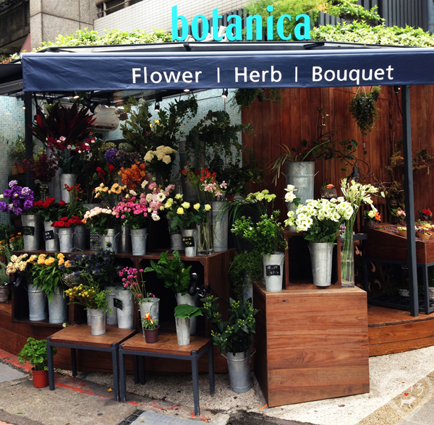
res∙tau∙rant
florist

Slide 23
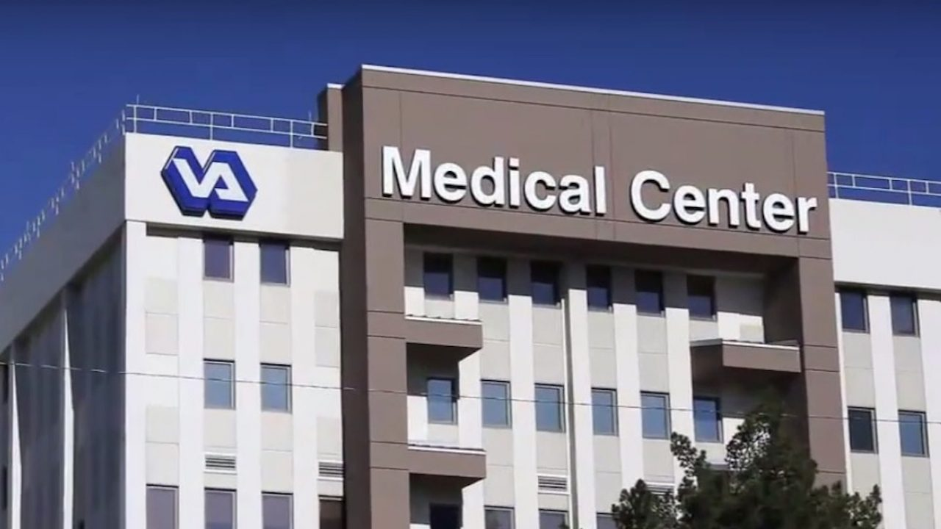
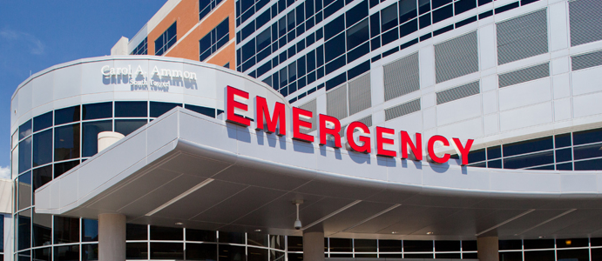
hos∙pi∙tal
hospital

Slide 24
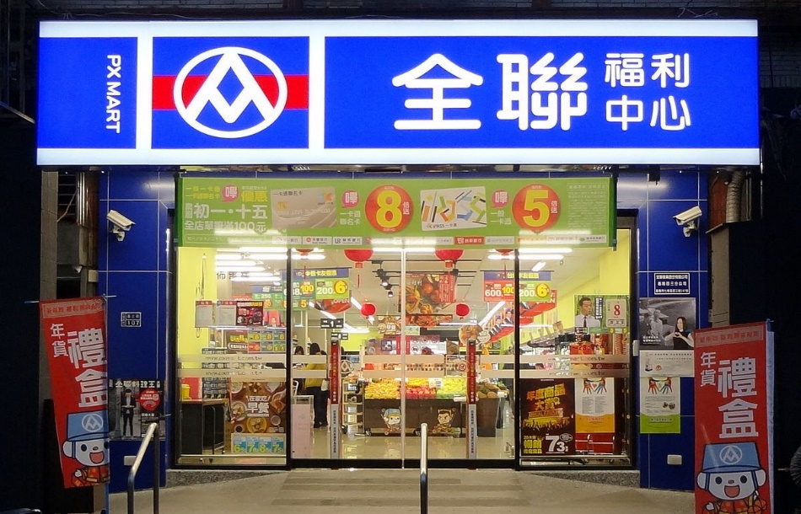
su∙per∙mar∙ket
supermarket

Slide 25
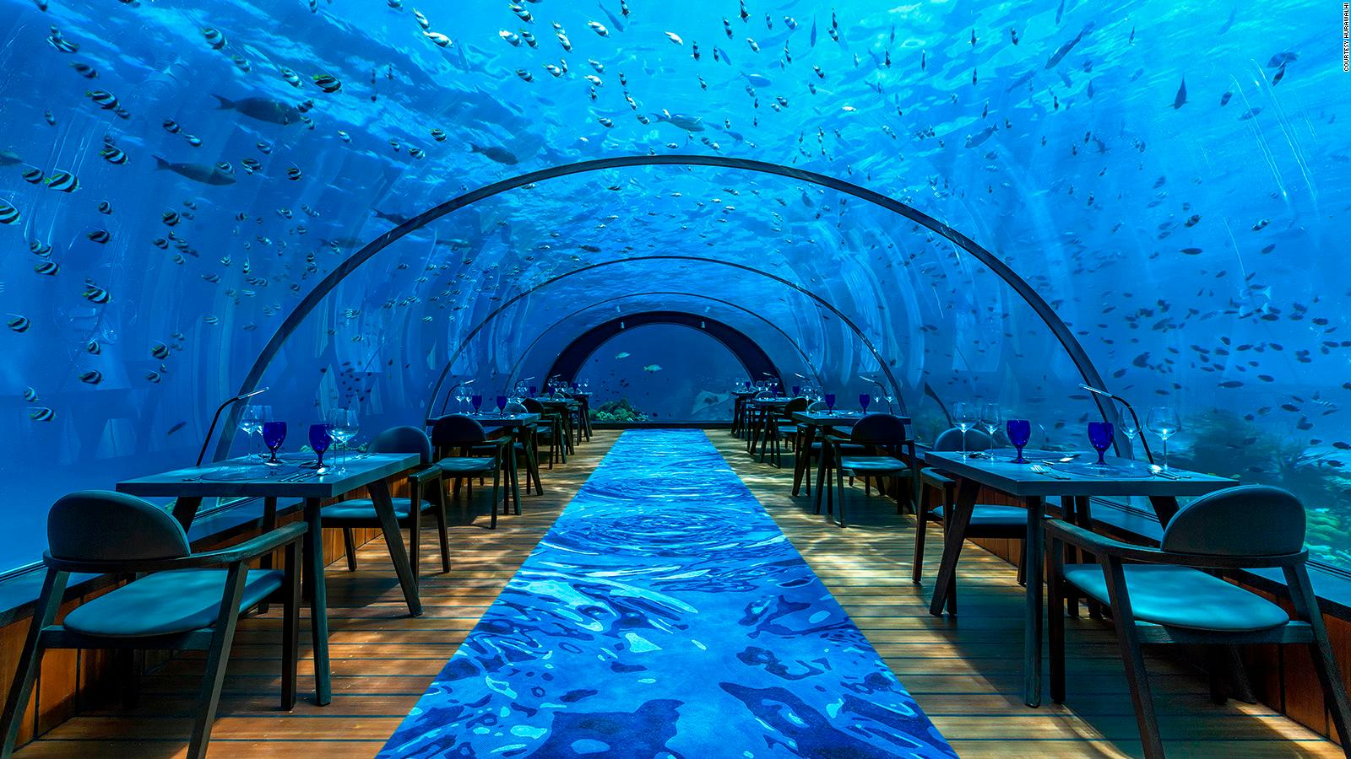
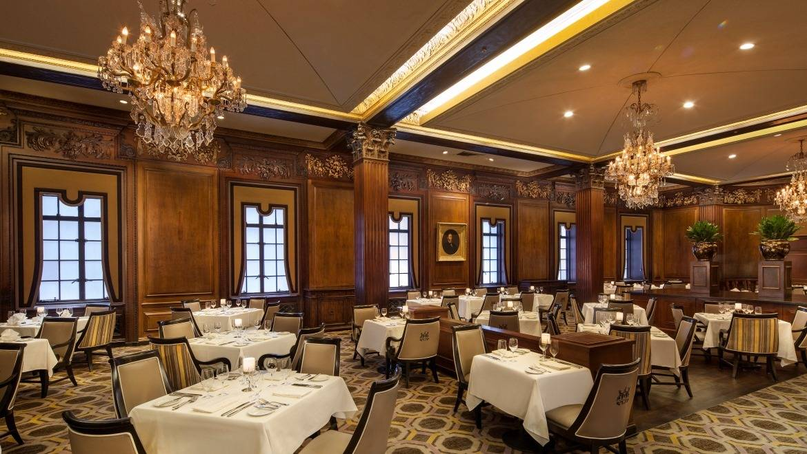
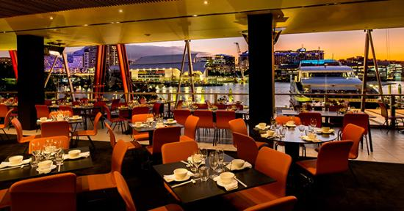
res∙tau∙rant
restaurant

Slide 26
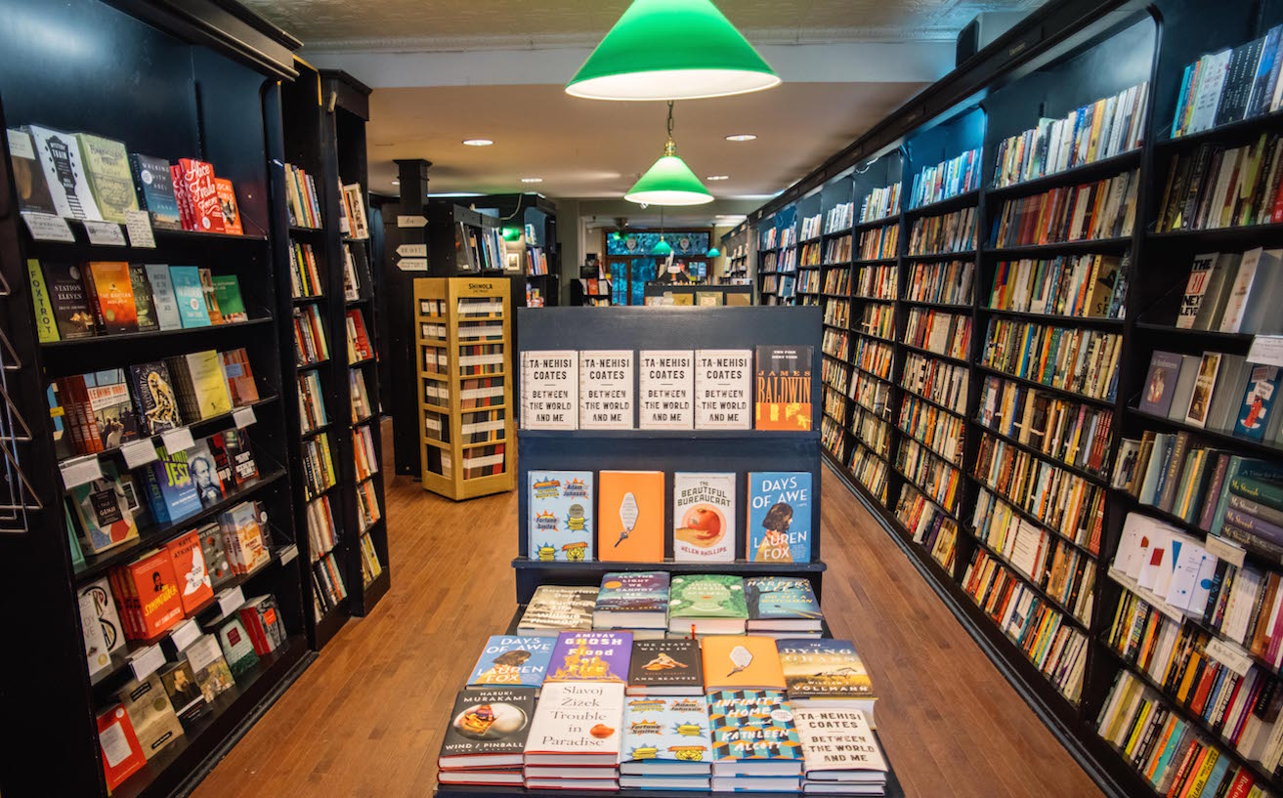
book∙store
bookstore

Slide 27
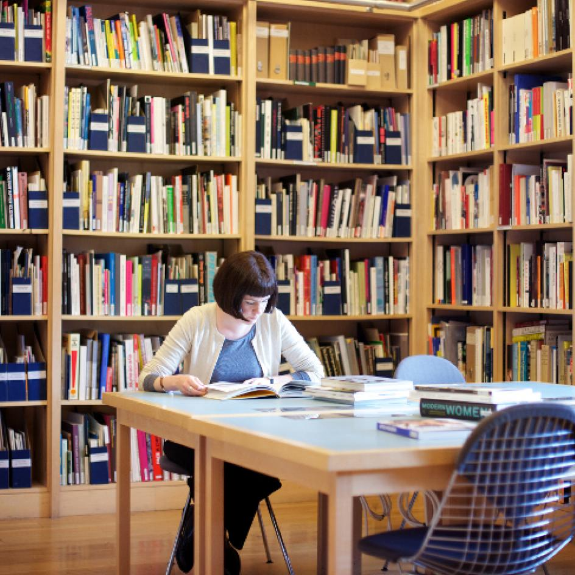
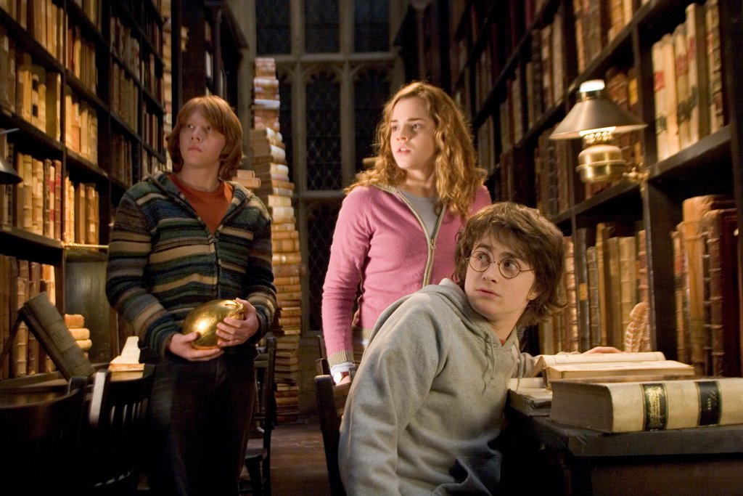
li ∙ bra ∙ ry
library

Slide 28
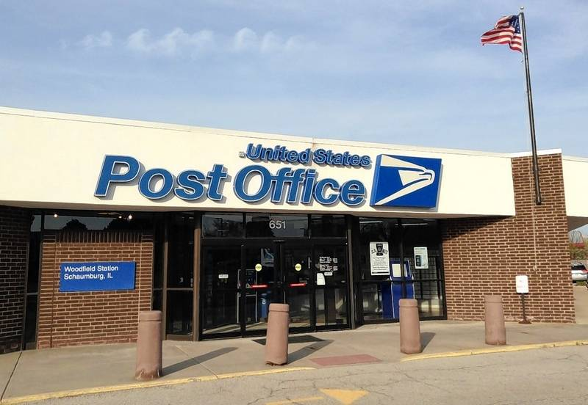
post office
post office

Slide 29
train station
train station

Slide 30
across from
/ə/
/ɑ/

Slide 31
between

Slide 32
next to

Slide 33
Where is the police station?

Slide 35
department store
park
police station
MRT
station
sports center
school

Slide 37
messy and neat

Slide 38
weak and strong

Slide 39
young and old

Slide 40
shy and outgoing

Slide 41
noisy and quiet

Slide 42
heavy and thin

Slide 43
rude and polite

Slide 44
short and tall

Slide 46
Daily
Activities

Slide 47
cleaned the room
clean the room
vacuum吸塵
〔d〕
sweep掃
mop拖

Slide 48
cooked dinner
cook dinner
〔t〕
宵夜
midnight snack late night meal

Slide 49
hyphen連字符號
play on-line games
played on-line games
〔d〕

Slide 50
washed the dishes
wash the dishes
〔t〕
do the dishes

Slide 51
watch a movie
watched a movie
see a movie 是指在電影院看電影，而 watch a movie 則是在電視上、電腦上或其他可觀賞影片的裝置上看電影。
〔t〕

Slide 52
water the flowers
watered the flowers
〔d〕

Slide 53
visit a friend
visited a friend
〔Id〕

Slide 54
walked the dog
walk the dog
〔t〕

Slide 55
listened to music
listen to music
〔d〕

Slide 56
surfed the Internet
surf the Internet
〔t〕

Slide 57
played the piano
play the piano
〔d〕
樂器前要加
the
play the flute吹笛
play the violin拉小提琴

Slide 58
did the laundry
do the laundry

Slide 59
yesterday
today

Slide 60
last night
Dec
17th
Dec
18th

Slide 61
last Friday
today

Slide 62
last weekend
Saturday and Sunday,
or Friday evening until Sunday night.
today

Slide 63
必須使用詳答才算全對!!!!!!
I cleaned the room last Friday.
I watched a movie last Friday.

Slide 66
From Fifth Grade to Sixth Grade, we have learned the English songs ……
Justin Bieber- Never Say Never
Handsome Dancer-CoinciDANCE
節慶: Michael Jackson- Thriller
Mariah Carey& Justin Bieber - All I Want For Christmas Is You
Grace VanderWaal -Moonlight
The Chainsmokers and Coldplay-Something Just Like This
Bon Jovi-It’s My Life

